Slide 1
Notes:
Introduction
Who am I
Name
Twitter
Email
Blog
Bio
What am I talking about & who is this talk for
Azure, WebApps & the Azure Services you can use
Aimed at developers, but could be used for IT professionals new to Could Computing
Throughout talk give overviews, basic setup & configuration and demos

Slide 2
AZURE SDK
https://www.microsoft.com/en-us/download/details.aspx?id=46892
VISUAL STUDIO COMMUNITY EDITION https://www.visualstudio.com/en-us/products/visual-studio-community-vs.aspx
AZURE PRICING CACLUATOR http://azure.microsoft.com/en-gb/pricing/calculator
Notes:
Assumptions
Basic HTTP and C# knowledge.
The Azure SDK and Visual Studio installed I'll be using 2013/2015 Community.
An Azure subscription.
I wont be talking about
Infrastructure-as-a-Service features
BI tools
No Billing, but there is a calculator

Slide 3


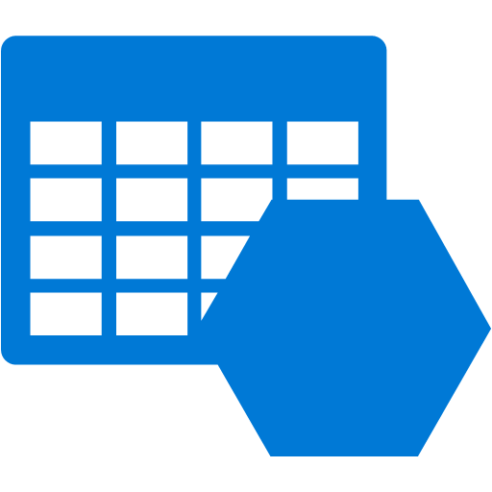



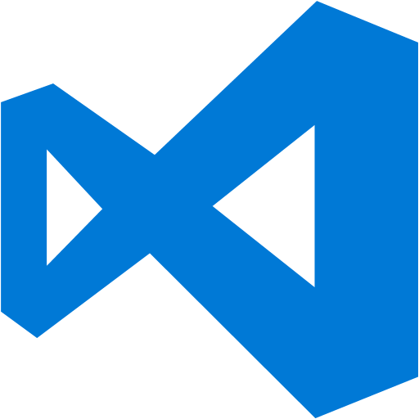
What is Azure
Notes:
Microsoft Azure is a cloud computing.
Try, answer the question "Why go to the cloud, why not use On-Premises servers?“

Slide 4
On-Premise Computing
Purchase exactly what you need
Setup and maintenance costs
Have you bought too much or too little hardware
Notes:
On-Premises Data Centres
Purchasing the hardware you need
Patch Tuesday, Yay! Added maintenance costs.
Times of high load? Can you deal with it?
You can! What is the unused hardware doing?

Slide 5


Notes:
As popularity increases, so does the hardware. Scale up.

Slide 6
Cloud Computing
Comes in 3 forms
SaaS – Software-as-a-Service
PaaS – Platform-as-a-Service
IaaS – Infrastructure-as-a-Service
Its universally available
Reduced cost
Notes:
Cloud Computing
Cloud Computing comes in 3 forms,
SaaS - Software-as-a-Service, such as Gmail.
PaaS - Platform-as-a-Service, for example hosting a website.
IaaS - Infrastructure-as-a-Service, such as a VM.
And you’ve probably used at lease one, universally available
Reduction in cost when choosing the cloud
No expensive licences
No maintenance costs

Slide 7
Notes:
Venders will also provide a range of services which will keep your costs down as well.
A common scenario is to use load balancers and auto scaling to provision just enough
hardware to cope with the current load. So you only pay for what you use.

Slide 8

Notes:
Azure is in 17 regions across the globe, plus another two location in China, via 21ViaNet a 3rd party provider.
Having so many data centres mean global deployments, or just to specific regions.
Some countries have laws protecting personal data, the Canadian Health Service for example.
Azure Services
Compute services
Azure Cloud Services
Azure WebApps
Azure Mobile Services.
Data services
Azure Storage
Azure SQL
Redis Cache.
Application services
Azure Active Directory
Service Bus
HDInsight
Azure Scheduler
Azure Media Services.
Network services
Virtual Networks
Azure Content Delivery Network
Azure Traffic Manager.

Slide 9
PORTAL DEMO
Notes:
All services can be managed through the portals.
There are two portals.
manage.windowsazure.com – the Production site
portal.azure.com – The preview portal.
Not all features migrated yet and some new features are only in the portal
This is where I will mainly be.

Slide 10
Azure WebApps
Notes:
A managed service
Quick deployments
Variety of supported languages
.Net
Java
Node
Python
To name a few

Slide 11






Webapp marketplace
Blog / cms
E-commerce
Notes:
In addition to building and deploying your own application, if you know you will be building an E-Commerce system or hosting a blog/CMS, the Azure team provide
a number of templates and framework in the Azure Marketplace.

Slide 12
Webapp demo

Slide 13
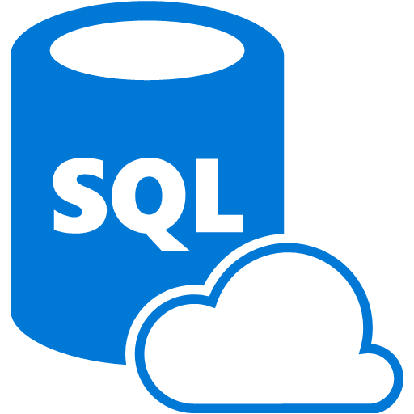
Azure SQL
Notes:
If you have an on premise server with a vanilla install of the latest version of Windows Server, how long will it take to provision a SQL Server install?
Lets create one now! I don't need you to time me this time.
While that is being setup it will talk a bit more about the Azure SQL Service.
What Azure is doing here is basically setting up a Database-as-a-Service. They are giving you a SQL Database in the cloud, which takes away all the maintenance and licensing costs.
And all that time spent setting up a SQL server has gone.
Azure SQL provides some great features such as,
Elastic Scale - If you business is doing well you may need to think about shading your DB. Azure provide a set of tools that will help you do so automatically.
Predicable Performance - Because each database is allocated a fixed amount of resource, even if there is a database on the same server being hammered, that wont effect your database.
Business Continuity - Each database in Azure SQL is part of a cluster of replication nodes, one primary and 2 secondary. All transactions are not considered successful until the data has been written to the primary and at least one of the secondary nodes. There is also the option to setup geo-replication.
And from the developer point of view, there is no major difference between Azure SQL and SQL Server. So you can continue using your favourite tools.

Slide 14
Azure SQL vs SQL Server
Azure SQL does not support
Windows Authentication
Distributed Transactions
Database Mirroring
SQL Server Agent / Jobs
Unsupported features - https://msdn.microsoft.com/library/azure/ee336281.aspx
Notes:
Azure SQL vs SQL Server
The Azure version of SQL is a cut down version of SQL Server. If you are thinking of using Azure SQL you should know it does not support,
Windows Authentication - The server is in the cloud not within your company network.
Distributed Transactions - Your cannot create linked servers, therefore you cannot commit transactions between them.
Database Mirroring - This feature of SQL Server is redundant due to the data replication nodes and the Geo-Replication that can be setup.
SQL Server Agent / Jobs - These are not supported on Azure SQL, but you can use the Azure Automation services to replace whatever jobs you were running.

Slide 15
Azure SQL vs SQL Server
Other Azure SQL differences
All Azure SQL tables must have a clustered index.
Idle connections will be closed after 30 mins
Azure SQL only accepts connection on port 1433
Notes:
Azure also does a few things differently,
All tables must have a clustered index
Idle connections are closed after 30mis
You can only connect to your SQL instance on port 1433

Slide 16

DocumentDB
Notes:
As well as Azure SQL Azure provide a range of other data storage technologies such as My SQL or Postgres in the relational family. Redis and Riak in the Key/Value family.
For graph databases there is Neo4j and in the Document database space there is Mongo, RethinkDb and Azure DocumentDB.
Azure DocumentDB is Microsoft's offering in the field of NoSQL JSON document databases.
DocumentDB is a fully managed document database as a service and designed to keep pace with modern rapidly evolving applications. DocumentDB nativly supports JSON and executes Javascript within it database engine. Meaning you can write and execute stored procedures and user defined functions directly on the database. DocumentDB automatically indexes all JSON documents, then allows you to query them with the familiar SQL syntax. A well as JavaScript Azure also provide SDKs in .Net, Java, Python and more, so you up and running quickly with the tools and languages you are already familiar with.

Slide 17
Azure Storage
Notes:
Azure Storage is another managed service that provides durable, scalable and redundant storage.
Every storage account currently gets 500TB of storage which can be used across its three services.

Slide 18

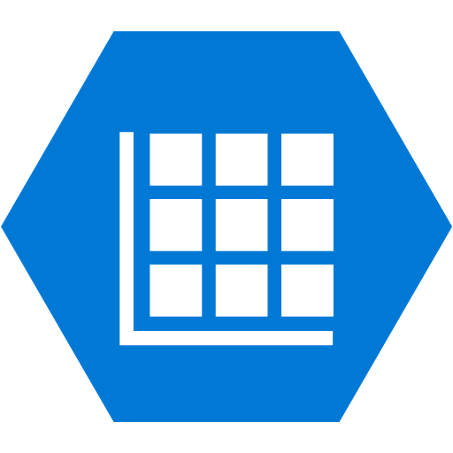

Azure storage
BLOB STORAGE
TABLE STORAGE
AZURE QUEUES
Notes:
Blob Storage
Table Storage
Azure Queues

Slide 19
BLOB STORAGE
BLOB = Binary Large Object
File system for the cloud
Client SDKs (.Net, Java, PHP, Node, Ruby & Python)
Unlimited containers & files, up to 500TB
http://[StorageAccountName].blob.core.windows.net/[Container]/[BlobName]
http://ritasker.blob.core.windows.net/cars/ford/mustang/eleanor-1967.png
http://ritasker.blob.core.windows.net/cars/chevrolet/camaro/bumblebee-2006.png
Notes:
Blob is an acronym for Binary Large OBject, which are files.
They can be anything from images to database backups. Due to the nature of the cloud you don't know which server your request has been sent to. So you should avoid saving files to the servers file system.
Blob storage gives you the ability to store and access files from anywhere in the world. You can interact with blob storage via its REST API or via any of the client libraries provided. You can also give read only access by sharing a URL to the blob.
You will need a storage account before you can access blob storage. Once you have one then you can start adding containers. Containers can be thought of like folders on you file system. A storage account can have an unlimited number of containers and a container can have an unlimited number of files, up to the storage account limit of 500TB.
Blob storage only allows for a single level of containers, therefore you cannot have containers within containers. But blob storage does try to simulate a hierarchical file system by pre-pending what would be folder names and slashes to beginning of the file name.
In the following examples, "cars" is the container name and everything after is the blob name. Depending on the blob storage viewer you use you will see a folder structure or just a list of blobs in the container.

Slide 20
TABLE STORAGE
Partition Key | Row Key | Time Stamp | Log Level | Message | Stack Trace
NE | ProdWR-1 | 10/07/2015 00:45:06 | INFO | data clean complete
WE | ProdAPI-3 | 10/07/2015 18:17:56 | ERROR | MyCustomException was thrown | ConsoleApplication1.MyCustomException: some message ....
Users By Email
Partition Key | Row Key | Time Stamp | First Name | Last Name
gmail.com | the. orinoco.strain | 08/05/1612 00:45:06 | John | Rolfe
hotmail.com | pocahontas | 02/04/1614 00:45:06 | Rebecca | Rolfe
Notes:
Table storage is a schema-less NoSQL data store, that is scalable, redundant and fast.
It is fast because every table has a clustered index which should be used to query the data.
The index consists of a Partition Key and a Row Key and together they make a unique ID. The Partition Key is used to shard the data between different nodes in the storage cluster, records with the same partition key are stored on the same node and the row key is used for uniqueness within the partition. The tables also have timestamp column which updates when the record is updated. The timestamp column is also used as an E-Tag to maintain data integrity.
As well as the 3 system properties each table entity can have up to 252 additional properties which are key / values. Because table storage is scheme less not every record needs all the properties.
In this example table storage is being used as a log. The first record is only logging the fact a clean up job had completed. The second has logged an exception, with a stack trace for someone to review later.
When designing your tables your really need to think about how to partition your data to get the maximum performance benefits.
In this example I have a collection of users indexed by email. The domain part and the local part of the email address has been used as the partition and row keys. When I search for a user by email I will split the email on the @ symbol and only search for the user within the relevant partition. Because you are querying on a subset of the data this is lighting quick.

Slide 21
Working with 154 million records on Azure Table Storage – the story of “Have I been pwned?”
Troy Hunt
http://www.troyhunt.com/2013/12/working-with-154-million-records-on.html
Notes:
Troy Hunt has written a really good blog post about how he setup table storage for his Have I been Pwnd site. In it he say that he had to put a 400ms delay into his code because table storage was returning too quickly and the UX didn't feel real.

Slide 22
AZURE QUEUES
Max message size, 64KB
Only limited by Storage Account size, 500TB
SERVICE BUS
AMQP
Transactions
Duplicate Detection
Dead-Lettering
Pub/Sub
More info at https://azure.microsoft.com/en-gb/documentation/articles/service-bus-azure-and-service-bus-queues-compared-contrasted/
Notes:
The Azure Queues is a simple service for storing and retrieving messages.
Each message a max limit of 64KB in size but you can have as many messages as you want in as many queues as you want up to the 500GB limit.
Azure does provide another queue service ServiceBus. This is a more advanced queue which follows the AMQP standard and has features such as sessions, topics, transactions, duplicate detection, automatic dead-lettering, and publish/subscribe capabilities. If you are interacting with external systems using the AMQP or just want to use some of these features then Service Bus might be for you. But if you are not concerned with that and you just want a simple way to communicate with the different parts of your app then Azure Queues would be the better choice.
For more info see, https://azure.microsoft.com/en-gb/documentation/articles/service-bus-azure-and-service-bus-queues-compared-contrasted/
Why Use Queues
What would you use queues for? A good example is a website that allows users to upload images. But the site needs to create a thumbnail for each image. The thumbnail generation will take a long time to complete. You wouldn't want to hold the user up while that process is happening. So uploading the image to blob storage and putting the image blob url in a message on a queue so the image can be processed outside of the webapp. Doing this stops the having to wait for the image to be processed before continuing. But also return the request thread to the thread pool freeing it up to handle the next request. Which is one of the first steps to make your site scalable.

Slide 23
STORAGE LIMITATIONS
Accounts / Subscription | 20
TB / Account | 500
Max File Share Size | 5TB
IOPS/ Account / Sec | 20,000
Throughput Single Blob | 60MB or 500 reqs
Throughput Single Queue | 2000 messages / sec
Throughput Single Table Partition | 2000 entities / sec
Max Ingress / Account (EU) | 5Gbps (GRS), 10Gbps (LRS)
Max Egress / Account (EU) | 10Gbps (GRS), 15Gbps (LRS)
https://azure.microsoft.com/en-gb/documentation/articles/azure-subscription-service-limits/

Slide 24
STORAGE DEMO
Notes:
In the portal create a storage account.
This little demo, uses the three parts to Azure storage to create a user account that has an avatar.
Walk through the code.
Paste the connection string into the App.configs
Run the Uploader
Show the different object.
Run the Processor.

Slide 25
Cloud services

Slide 26
Cloud services vs Cloud services
Service for managing VM clusters
Single Point of Entry
Load Balancer
Availability
Consists of Web and Worker Roles
Notes:
In Microsoft’s infinite wisdom they have given the same name to two different Azure services.
One is a management tool for VM clusters. Which provides features like,
Providing a single point of entry for VM clusters
Load balancing between the clustered VM nodes
Maintaining the availability of the nodes.
The other is made up of managed VMs called Web Roles and Worker Roles.
Cloud Services is an example of one of the Platform-as-a-Service technologies available on Azure.
It is another managed service so no patching etc.
Although you can RDP to the VM for extra configuration options.
Cloud Services are perfectly suited for application that need to scale reliably with low administration needs.
Azure provide SDKs for a multitude of languages.
.Net
Java
PHP
Python
Node.js
and more
Both the Web and Worker roles have an Entry Point class which methods that are called by the Cloud Service at specific points in the roles lifetime.
OnStart - Any setup codes goes here, and has to return true or the role will recycle and try again.
Run - This is where the main roles code is called from, this should be a infinite loop. If this method throws an exception the role will be recycled.
OnStop - Any tear down code goes in here. So if you need to clear queues or need write to logs before the roles is stopped.

Slide 27


CLOUD SERVICES
WEB ROLES
Runs IIS
Multiple Endpoints
OnStart executes before the web app starts
WORKER ROLES
Doesn’t run IIS
Doesn’t affect the performance of web roles
Notes:
Web Roles
Run on top of IIS, so you can host ASP.Net Websites and Web APIs, WCF Services or any other technology that can be ran on IIS.
You can have multiple application endpoints in one Web Role instance. For example, you could expose your app via a HTML interface, a REST API or a WCF service.
The Azure Cloud Service calls the OnStart event before the it starts the main web application. This means you can get the app into a ready state, like prepopulating a cache or creating tables or queues.
Worker Roles
WorkerRoles don't run on IIS. They can be considered as Windows services that execute background tasks but in the cloud.
Worker Roles are hosted in their own VMs. So any heavy lifting the Worker Roles does wont impact on the performance of other recourses. Unlike WebJobs but I will come on to that later.
The Web / Worker Role pattern is a common architectural design pattern within the Azure Cloud Services, common scenarios for this pattern is to have the Web Role handle any HTTP requests coming in to the app. Then for the Web Role to pass any intensive work off to the Worker Role usually via a queue.

Slide 28
WORKER ROLE DEMO
Notes:
In this demo I have taken the create user example. Striped out the processor and replaced it with a Worker Role.
Get the connection string from Azure and paste it into the different configs.
Publish the worker role.
Walk through the code. While the publish happens in the background.

Slide 29
Web Apps vs Web Roles
WEB APPS
Similar to regular web hosting
Deploy via FTP
Templates available in the Marketplace
WEB ROLES
Greater environmental control
Multiple deploy slots
CDN Integration
Better Scaling
Notes:
By now, you should know a bit about WebApps and Web Roles in Azure. You can probably see the similarities, but are asking yourself what are the differences? Or, When would I use one over the other?
WebApps
The Azure WebApps service is very similar to any other hosting company. You can deploy files using FTP, or use git to instantly update the files on commit. Azure WebApps provide templates and frameworks via the Marketplace. All the familiarities you have with traditional webhosting is here in Azure WebApps.
Web Roles
Web Roles is where the magic happens. A Web Role is a cloud service, when using cloud services you are getting the full PaaS experience.
Web Roles give you more control over the environment, unlike traditional hosting and WebApps you can RDP on to the servers and get direct access to IIS, if you are running Windows. But you don't have to worry about patching and maintaining the server the Azure team takes care of it.
WebRoles get two staging slots by default, in WebApps you only get the one but you can add more manually. When you setup a new Web Role a Staging and Production environment is created for you. These environments are identical, this mean you no longer have the worry of your code working in the staging/test environment and crashing in production.
There a higher level of CDN integration, it requires a little configuration but because you have more control it can be done. The same goes for scripts that require elevated privileges, if you are thinking about migrating a legacy system to Azure then you are able to run those scripts with a Web Role.
Lastly scaling works differently in Web Roles. With a WebApp you scale out the number of VMs running. In Web Roles you can still just increase the number of VMs you have, but you can also increase the number of Web Role instances are running in the VM.

Slide 30

Web Jobs vs Worker Roles
WEB JOBS
Run background programs or scripts
On-demand or continuously
WebJobs and WebApps share resource
Can be triggered
Notes:
I have told you that any heavy lifting or any background task should be done with a worker role rather than you app and that still holds true. But let me introduce you to the worker roles little brother the WebJob.
WebJobs allow you to run programs or scripts in your WebApp service. You can run a WebJob either on demand or continuously.
WebJobs run along side you WebApp and uses the same resources, hence why I say its the worker roles little brother as you will still want to do any intensive work with a worker role because they wont effect the performance of the web app.
Webjobs can be as simple as Console.Writeline("Hello world") or you can use the Azure WebJobs SDK to pull in cool features such as triggering a job when a file is uploaded to a blob storage container or when a message is put on a queue.
So if the Web and Worker role architecture is too much for your small WebApp then WebJobs is one of the many services available and waiting for you on Azure.

Slide 31
SUMMARY
On- Premise Vs Cloud Computing
Azure and the Portals
WebApps
Azure SQL
DocumentDB
Azure Storage
Service Bus
Cloud Services

